Slide 1

Heart Disease Prediction with Machine Learning
Aritzi Piedras Silva
DSC 680 Spring 2021
First Project – Milestone4

Slide 2
Overview
Research Question
Dataset Selection
Methodology
Exploratory Data Analysis
Model Selection
Conclusion
Q&A

Slide 3
Research Question
Can we use Machine Learning to predict heart disease?
- According to the Center of Disease Control and Prevention, forty percent of premature deaths related to heart disease can be prevented by modifying different risk factors such as smoking, physical inactivity, unhealthy diets, and stress levels. Unfortunately, medical errors and undesirable results are the reasons that computer-based diagnosis to achieve high quality medical procedure results.

Slide 4
Dataset Selection
Dataset link:
https://www.kaggle.com/ronitf/heart-disease-uci
Overview:
This dataset was found Kaggle as a CSV – the original dataset contained 76 attributes; however, this subset only contains 14 of them as the original dataset contained sensitive information. This subset as I mentioned contains 14 columns with 303 rows containing health profiles of different patients.

Slide 5
Methodology
Classification machine learning
Predicting whether or not patient should be diagnosed with Heart Disease – therefore the outcome is binary.
Algorithms used:
- Logistic Regression
- Decision Trees
Random Forest Trees
Using these three algorithms will allow me to cross validate which model has the best performance in accuracy in detecting heart disease.

Slide 6
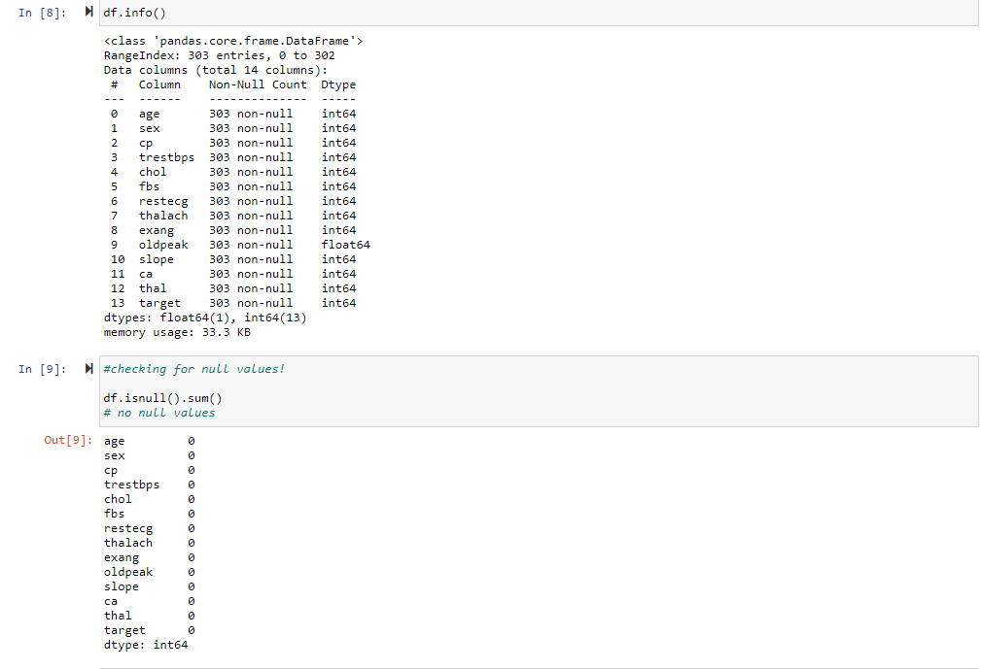
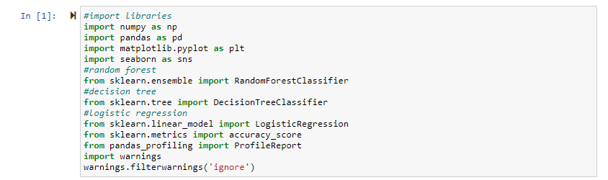
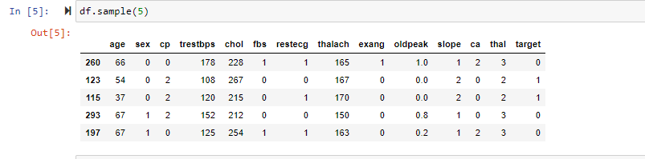
Data Wrangling

Slide 7
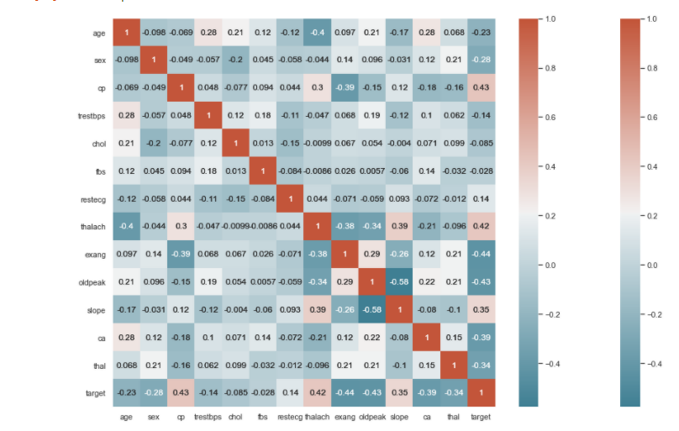
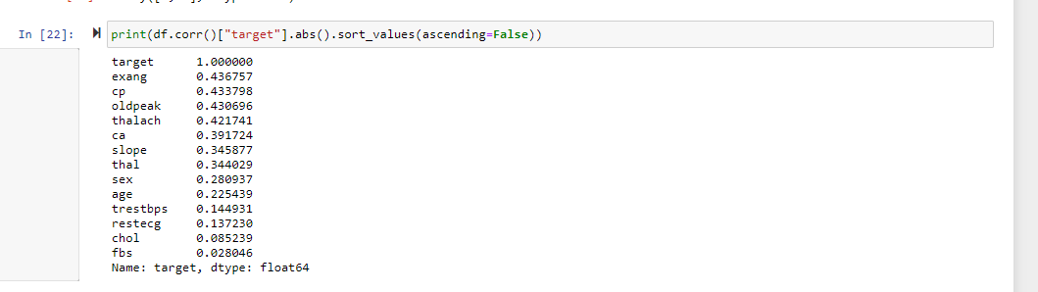
Exploratory Data Analysis Correlation with Predictor (Target)
Moderate correlation with Target overall but it gets VERY weak with FBS. Fasting Blood Sugar.
Chest Pain and Exang(Exercise induced angina(chest pain) highest correlated.

Slide 8
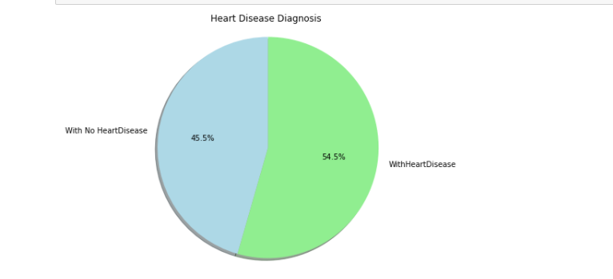
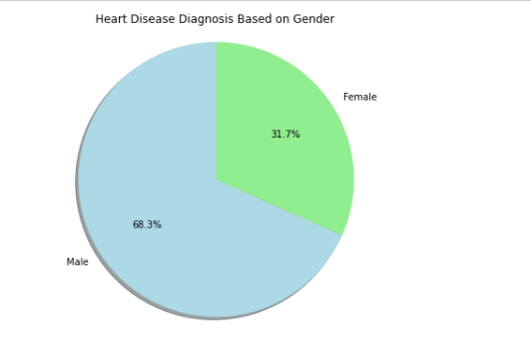
Exploratory Data Analysis Visualizations

Slide 9
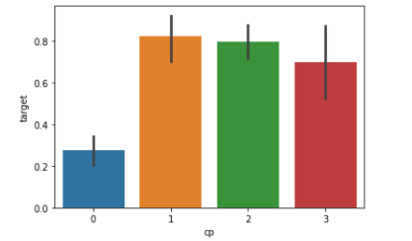
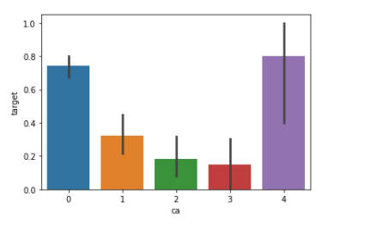
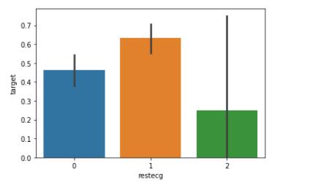
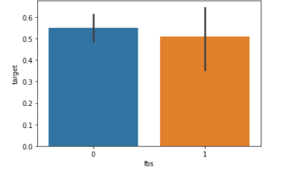
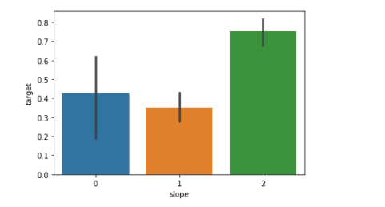
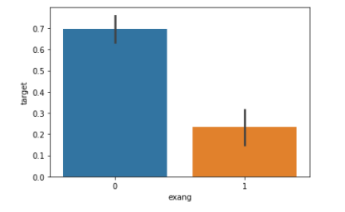
Exploratory Data Analysis Visualizations

Slide 10
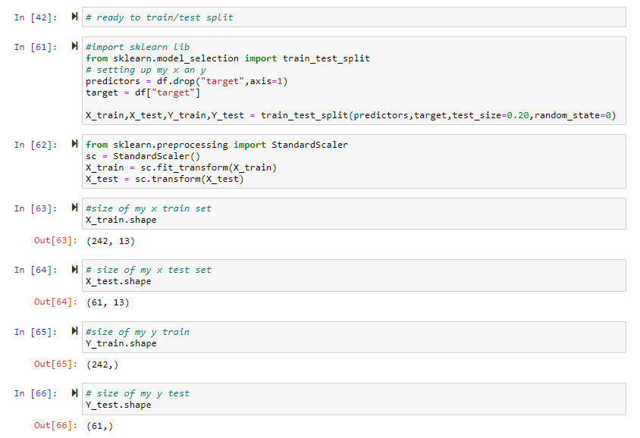
Model Fitting Prepare for modeling
Assigned: the 13 features to ‘Predictors’ variable and ‘Target’ to the target feature.
Split dataset into training set and test set
Standardized the data so that the distribution will have a mean of 0 and standard deviation of 1.

Slide 11
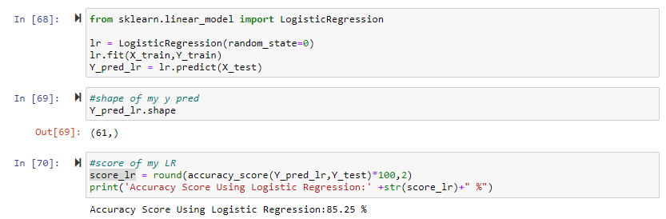
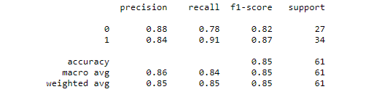
Model Fitting Logistic Regression
Logistic Regression had a performance of 85.25%.

Slide 12
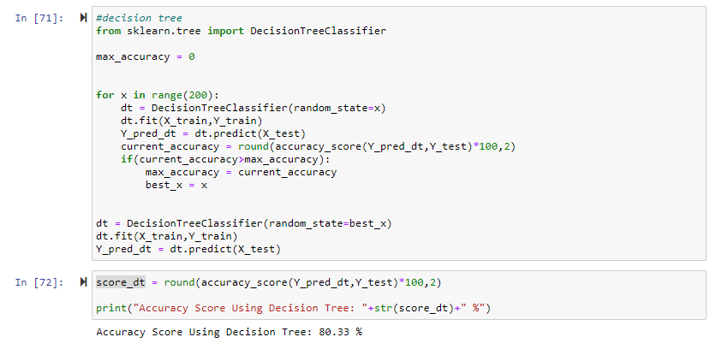
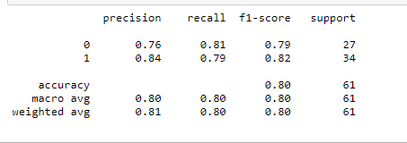
Model Fitting Decision Tree
Decision Tree had a performance of 80.33%.

Slide 13
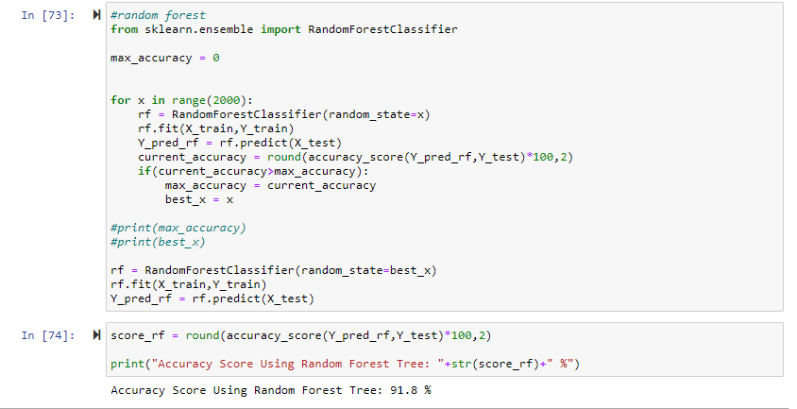
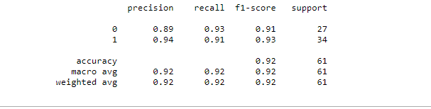
Model Fitting Random Forest
Random Forest had a performance of 91.8%.

Slide 14
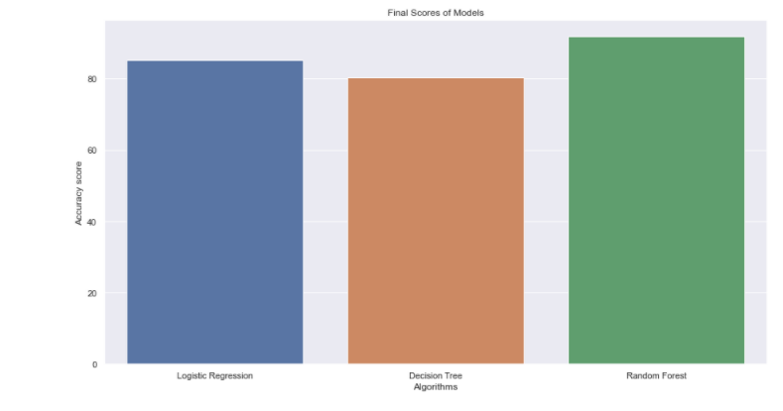
Visualization of models

Slide 15
Conclusion
Chest pain (‘cp’) and the number of major vessels(‘ca’) are important features that helped distinguished between a positive or negative diagnosis.
Random Forest algorithm had the highest accuracy of 91.8% which allows the medical field to provide better diagnosis to patients and prevent more deaths in the US.
With machine learning we are able to predict early signs of heart disease, this will allow professionals to provide adequate advise in order to prevent much worse symptoms to arise in the future for any individual.

